Slide 1
Hands-on-labs WingTipTickets
Guy Haycock – Principal Product Planner
Azure SQL Database – guyhay@microsoft.com

Slide 2
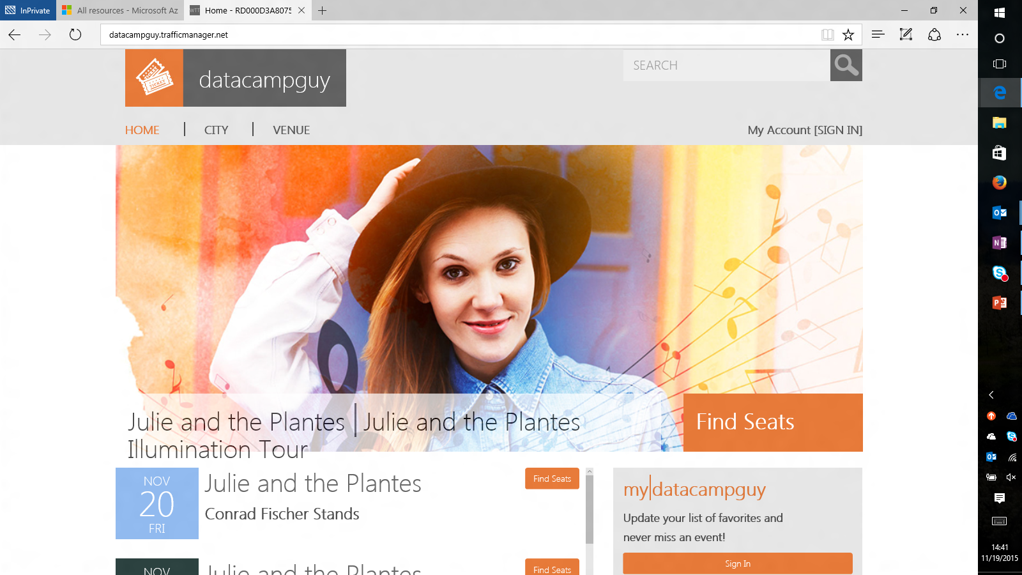
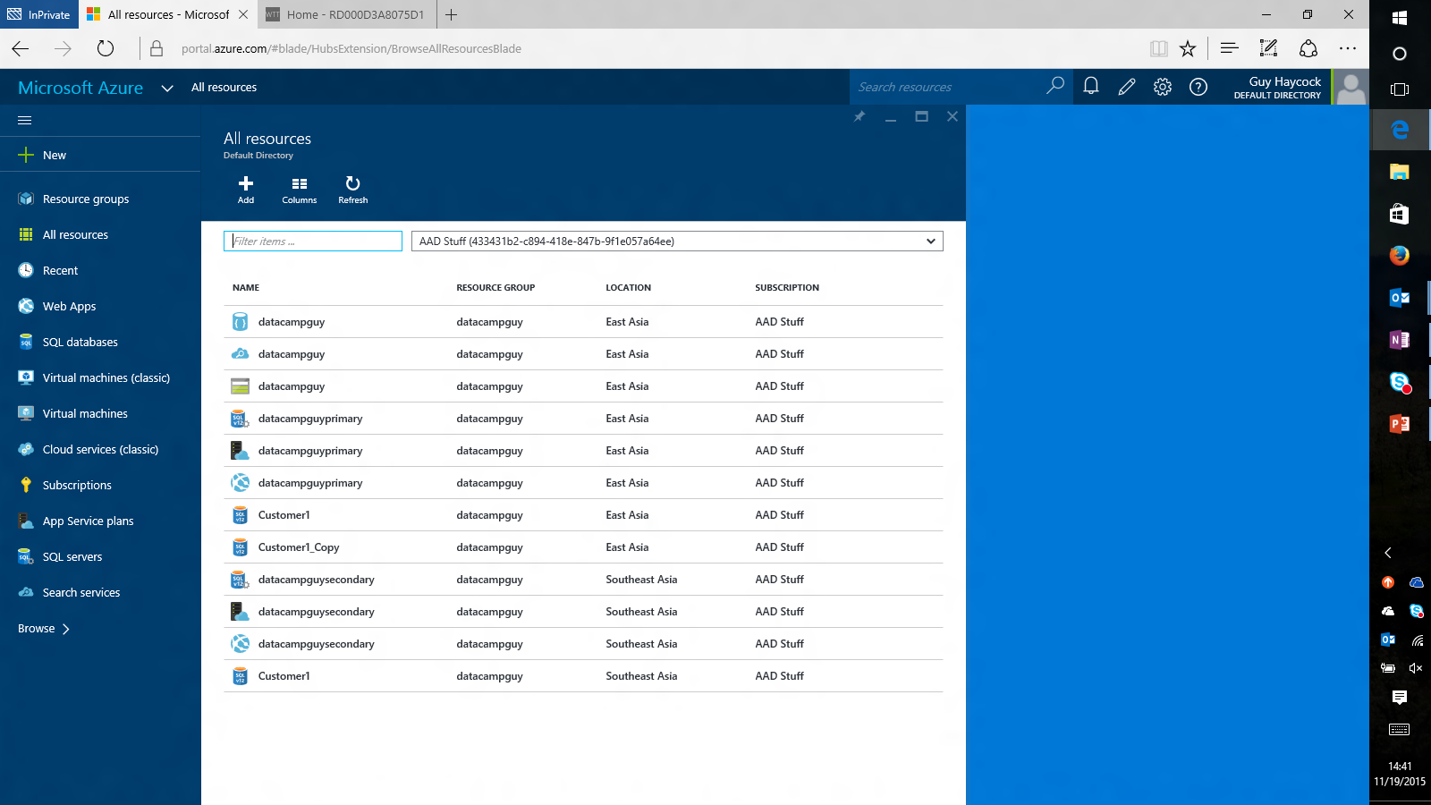
Your demo Azure application after deployment
End-customer view
ISV DevOps view

Slide 3
WingTipTickets Architecture
Traffic Manager <http://datacampguy.trafficmanager.net/ >
Primary region <East Asia>
Primary
Azure WebApp <http://datacampguyprimary.azurewebsites.net/ >
Primary Database
Tables:
Concerts
Customers
Tickets
Venues etc.
SQL DB Geographic Replication
Secondary region <South East Asia>
Secondary
Azure WebApp <http://datacampguysecondary.azurewebsites.net>
Secondary Database
Tables:
Concerts
Customers
Tickets
Venues etc.

Slide 4







WingTipTickets Detailed Architecture
TABLES:
Concerts
Customers
Day two services
Tickets
Venues
Day one services
Power BI
Azure Data Warehouse
Azure Web App
Customer Database
Azure Data Factory
Azure Document DB
Azure Search

Slide 5
Picture of sucess
Goal of the data-camp is to provide hands-on with http://portal.azure.com
WTT is an example Azure app that uses many Azure data services (SQL DB, Websites, Traffic manager, Blobs, DocumentDB, Search, ADF, SQL DW, PowerBI) http://datacampguy.trafficmanager.net/
You can use this while you are here or after you return home https://github.com/guyhay/wingtiptickets
You can pair with a colleague if you want
Tasks
What you need
Ensure that you can login to http://portal.azure.com
Ensure that you can connect to your VM
Complete the provisioning process for the HOL C:\WingTipTickets from your VM
A paid Azure account, either your own or using an Azure Pass from us
One of the VMs with the client tools RDP instructions https://www.yammer.com/azureadvisors/#/groups/6596026/files or the card
Detailed instructions (either this PPT, or the configuration guide both on GitHub)

Slide 6
Azure demo
http://portal.azure.com
Create DB
Connect to DB from SSMS

Slide 7
HOL Setup Steps
Connect to your VM (e.g. ‘wingtipnov17datacamp132’) and navigate to C:\WingTipTickets
Launch Azure PowerShell (as an administrator) https://github.com/guyhay/WingTipTickets/blob/master/Azure%20SQL%20HOL%20Configuration%20Guide%20-%20Final.docx
Add-AzureAccount
Optional - Select-AzureSubscription –SubscriptionId <provide your subscription that you want to use>
Set-ExecutionPolicy -Scope LocalMachine -ExecutionPolicy Unrestricted –Force
CD c:\WingTipTickets\scripts
Unblock-file .\New-WTTEnvironment.ps1
. .\New-WTTEnvironment.ps1
New-WTTEnvironment -WTTEnvironmentApplicationName <your-globally-unique-app-name>
Super-tricky syntax. Full-stop space full-stop backslash

Slide 8
Azure SQL DB demo
Vertical scaling
Delete DB
Restore DB

